Slide 1


Predict Customer Personality to boost marketing campaign by using Machine Learning
Created by:
Mario Trianto
mario.3anto@gmail.com
www.linkedin.com/in/mario-trianto
Detail-oriented Product Planner with a background in Mechanical Engineering and recent specialization in data science. With over two years at PT. Honda Prospect Motor, I bring expertise in cross-functional project management, trend analysis, and strategic product positioning. Having completed a data science bootcamp with excellent grades, I am skilled in Python, SQL, data preparation, exploratory data analysis, and machine learning. I’m eager to leverage my analytical strengths and insights to drive data-driven decisions in a data science role that bridges business strategy with impactful data solutions.

Slide 2
Overview
“Sebuah perusahaan dapat berkembang dengan pesat saat mengetahui perilaku customer personality nya, sehingga dapat memberikan layanan serta manfaat lebih baik kepada customers yang berpotensi menjadi loyal customers. Dengan mengolah data historical marketing campaign guna menaikkan performa dan menyasar customers yang tepat agar dapat bertransaksi di platform perusahaan, dari insight data tersebut fokus kita adalah membuat sebuah model prediksi kluster sehingga memudahkan perusahaan dalam membuat keputusan ”

Slide 3
Exploratory Data Analysis

Slide 4
Data Information and Assumption
Dataset consist of customer demography & activity on the platform
Dataset shape: 30 column by 2,240 row
Since no specific explanation on each label, below assumption is made:
Dt_Customer
→ date when customer join membership
Income
→ customer yearly income in Rupiah
MntCoke, MntFruits, MntMeatProducts, etc.
→ customer expenditure on each category
NumDealsPurchases, NumWebPurchases, NumCatalogPurchases, etc.
→ number of customer transaction on each platform/sources
Response
→ number of customer interaction on the marketing campaign
AcceptedCmpX
→ customer who has accepted a specific marketing campaign, labeled as "Campaign X"
Please check this Jupyter Notebook file here for more details

Slide 5
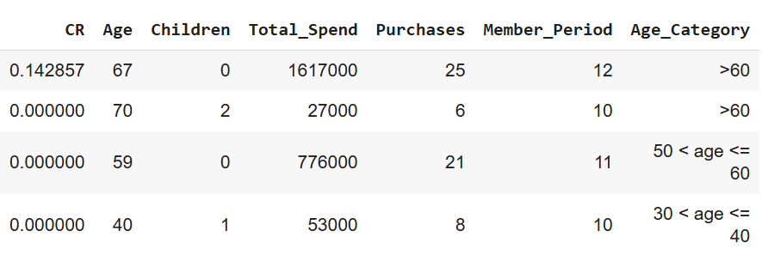
Feature Engineering
For in depth analysis & modelling, several relevant features are engineered as below:
1
2
3
4
5
6
7
CR (Conversion Rate)
Ratio between “Response” and “NumWebVisitsMonth”
Age
Age of the customer (current year - “Year_Birth”)
Children
Number customer’s children (“Kidhome”+”Teenhome”)
Total_Spend
Total customer’s expenditure (sum of “MntXxx”)
Purchases
Total customer’s purchases (sum of “NumXxxPurchases”)
Member_Period
Customer’s membership age in year (current year - “Dt_Customer”)
Age_Category
Divide age to several category for ease of EDA
Please check this Jupyter Notebook file here for more details
Please check this Jupyter Notebook file here for more details

Slide 6
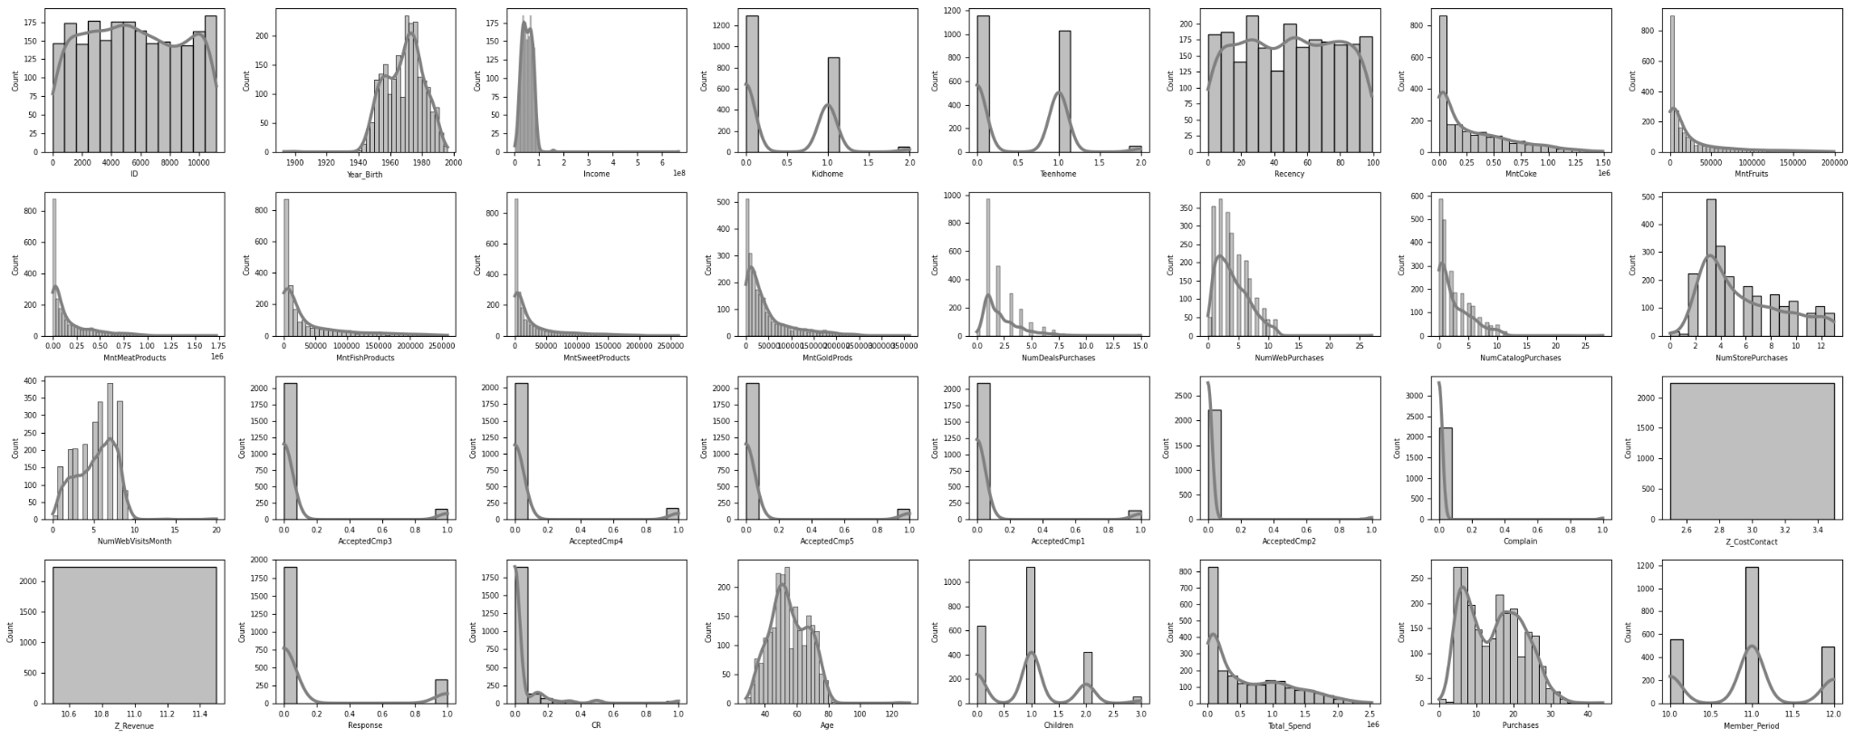
Exploratory Data Analysis
Numeric Data Distribution
Please check this Jupyter Notebook file here for more details

Slide 7
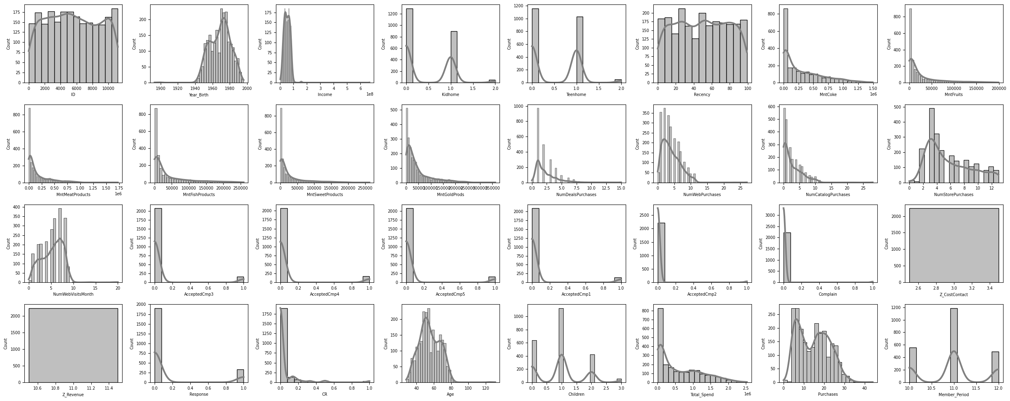
Exploratory Data Analysis
Numeric Data Distribution
Year_Birth:
Most customers are born in the 90s
Kidhome:
Most customers have 0-1 kid
Teenhome:
Most customers have 0-1 teen
Children:
Most customers have a total of 0-2 kid and teen
Income:
Most customers’ income is below 100 Mil Rupiah with extremes up to 660 Mil Rupiah (right skewed)
Please check this Jupyter Notebook file here for more details

Slide 8
Exploratory Data Analysis
Numeric Data Distribution
Total_Spent
Most customers spends <500K Rupiah (right skewed)
Purchases:
Ranges from 5-30 transaction (right skewed)
MntXxx:
Mostly have a right skewed distribution
Please check this Jupyter Notebook file here for more details

Slide 9
Exploratory Data Analysis
Numeric Data Distribution
CR (Conversion Rate)
Average conversion rate is ±4% (right skewed)
Age:
Most customer is middle aged with a quite normal distribution
Member_Period:
Ranges from 5-30 transaction (right skewed
Please check this Jupyter Notebook file here for more details

Slide 10
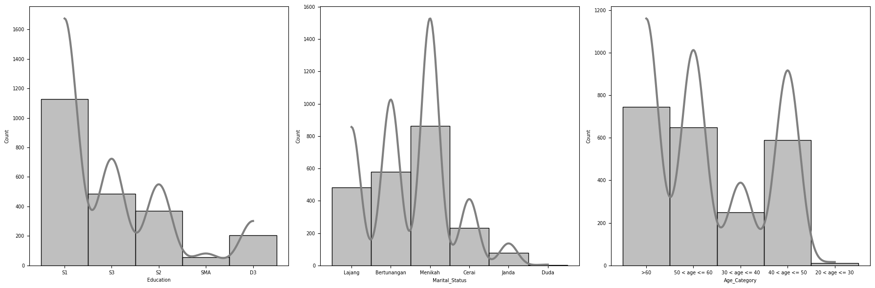
Exploratory Data Analysis
Categorical Data Distribution
Education
Most customer has a bachelor’s degree
Marital_Status:
Most customer is engaged or married
Age_Category:
Most customer’s age is >40 years old
Please check this Jupyter Notebook file here for more details

Slide 11
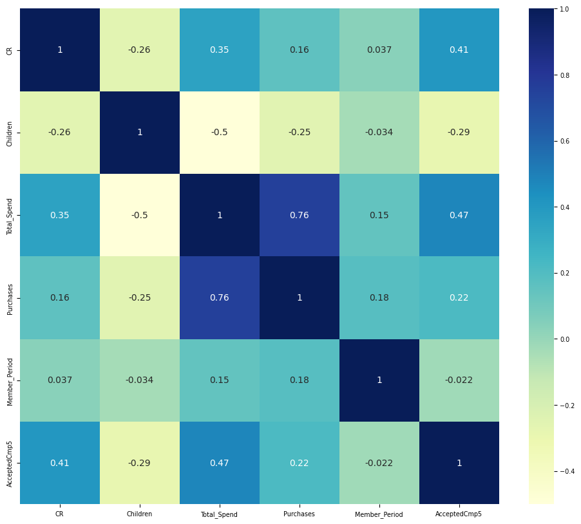
Exploratory Data Analysis
Data Correlation
Heatmap
Insights:
Age & CR : No correlation
Children & CR : Slight negative correlation
Total_Spend & CR : Slight positive correlation
Purchases & CR : Slight positive correlation
Member_Period & CR : No correlation
AcceptedCmp5 : Positive correlation
Please check this Jupyter Notebook file here for more details

Slide 12
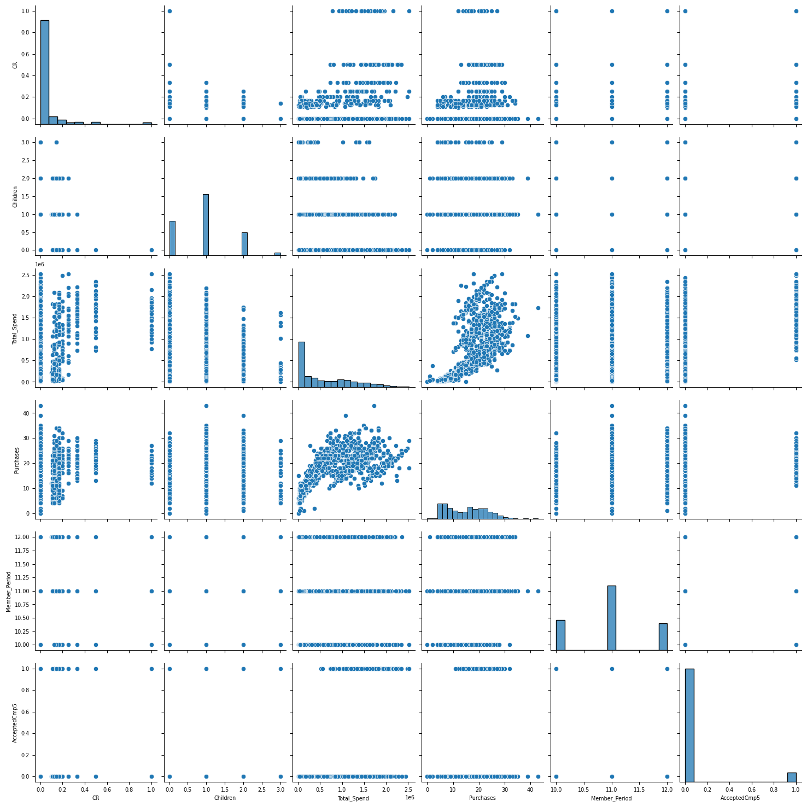
Exploratory Data Analysis
Data Correlation
Pair Plot
Insights:
Children & CR
Customer who has fewer or no children tends to have higher conversion rate
Total_Spend & CR
Customers who spends more on the platform tends to have higher conversion rate
Purchases & CR
Customer who make more purchase tends to have higher conversion rate
AcceptedCmp5 & CR
Although quite strong positive correlation based on heatmap, correlation is unclear in the pair plot. Possibly due to high discrepancies between 1 & 0 on AcceptedCmp5
1
2
3
4
Please check this Jupyter Notebook file here for more details

Slide 13
EDA Summary
Key Takeaways:
Current average conversion rate of the marketing campaign is ±4%
Age almost have no correlation with conversion rate
Conversion rate are correlated with below features:
Children : fewer to no children tends to have higher conversion rate
Total Spend : higher spend tends to have higher conversion rate
Total Purchase : more purchase tends to have higher conversion rate
AcceptedCmp5 : positive heatmap correlation however unclear correlation in pair plot
Please check this Jupyter Notebook file here for more details

Slide 14
Data Pre-Processing

Slide 15
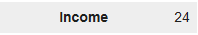
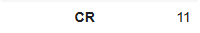
Handle Missing Value & Duplicated Data
Handle Missing Value
Based on the analysis, there is a missing value on below fields:
Income : 24
CR : 11
Since relatively small compared to the total data, these missing value will be removed from the dataset
Handle Duplicated Data
Based on the analysis, there is no duplicated data on the dataset
Please check this Jupyter Notebook file here for more details

Slide 16
Feature Encoding
Categorical features:
Education
Marital_Status
Since these features are non-ordinal, One Hot Encoding (OHE) will be applied
Education
S1
S1
S1
S1
S3
Education_S1 | Education_S3
1 | 0
1 | 0
1 | 0
1 | 0
0 | 1
Marital_Status
Lajang
Lajang
Bertunangan
Bertunangan
Menikah
Marital_Status_Lajang | Marital_Status_Bertunangan | Marital_Status_Menikah
1 | 0 | 0
1 | 0 | 0
0 | 1 | 0
0 | 1 | 0
0 | 0 | 1
Please check this Jupyter Notebook file here for more details

Slide 17
Feature Selection
Based on the dataset description, correlation heatmap and feature engineering, below features will be dropped:
Reason | Features
Irrelevant features: | ID
Same value for all customer: | Z_CostContact, Z_Revenue
Redundant w/ Total_Spend: | Income, Purchases
Redundant w/ AcceptedCmp5: | AcceptedCmpX
Small correlation w/ CR: | Education, Marital_Status, Member_Period, Age, Age_Category, Recency
Included on engineered features: | Year_Birth, Kidhome, Teenhome, Dt_Customer, MntXxx, NumXxxPurchases, Response, NumWebVisitsMonth
Please check this Jupyter Notebook file here for more details

Slide 18
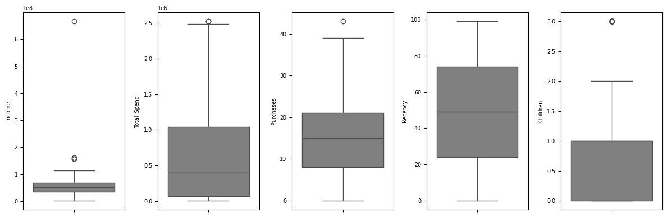
Outlier Handling
"Children" data are only spread on small value variation, therefore outliers will not be removed
No outlier detected on "Recency"
Use IQR to handle outliers on "Income", "Total_Spend", & "Purchases“
Rows before outlier filtering : 2206
Rows after outlier filtering : 2198
Please check this Jupyter Notebook file here for more details

Slide 19
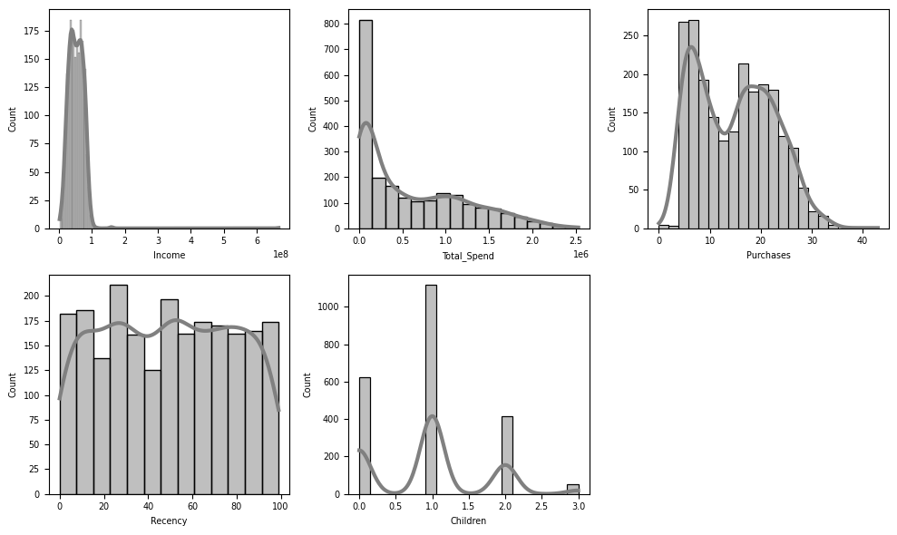
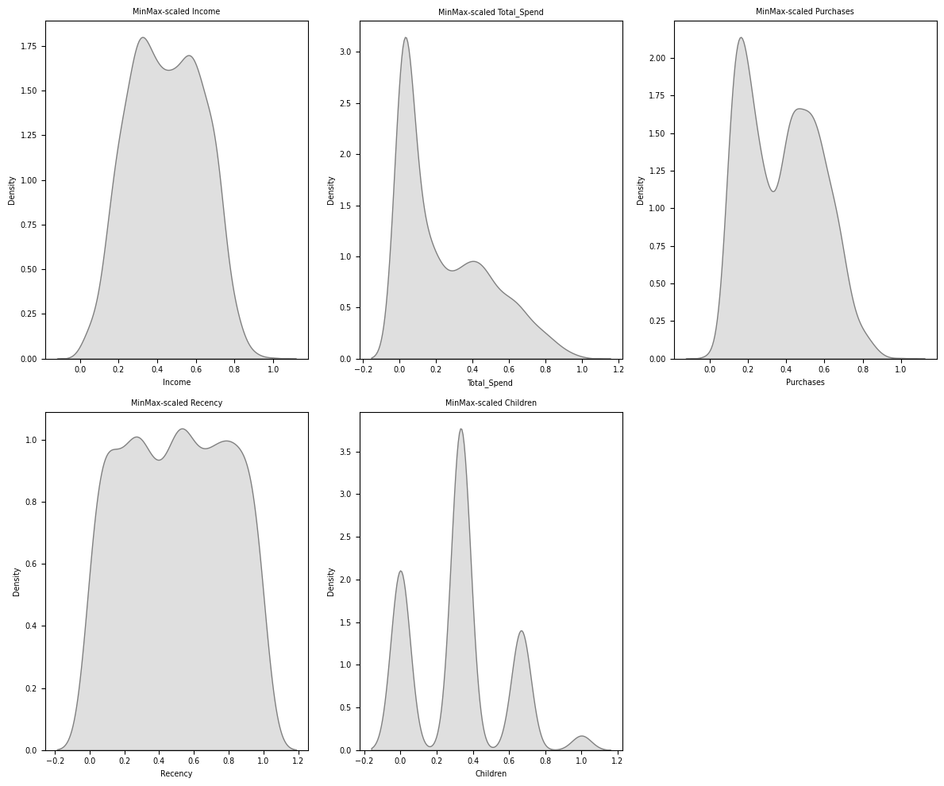
Feature Standardization
The numerical features needs to be standardize so the feature influence can be equalized
The data standardization is done using min-max scaler
Please check this Jupyter Notebook file here for more details

Slide 20
Clustering

Slide 21
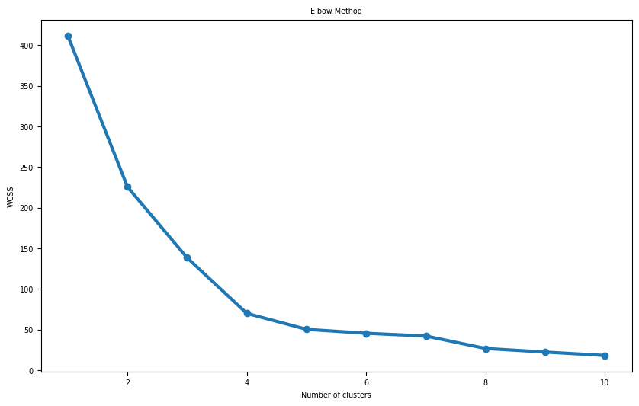
Cluster Number
Feature that is used for clustering: “Total_Spend”, “AcceptedCmp5”, & “Children”
Clustering method: K-Means clustering
Using Elbow Method, the optimal number of cluster is either 4 or 5 cluster (as seen on below graphic)
Optimal number
of cluster
4
5
Please check this Jupyter Notebook file here for more details

Slide 22
Silhouette Score
Silhouette score for various number of clusters is as below table:
Number of Clusters | Silhouette Score
2 | 0.6719952199591978
3 | 0.47981786689326594
4 | 0.5603286180064139
5 | 0.5986645429261973
6 | 0.607501848765953
Based on the silhouette score, 5 is the ideal number of cluster to gain optimum & detailed separation
Please check this Jupyter Notebook file here for more details

Slide 23
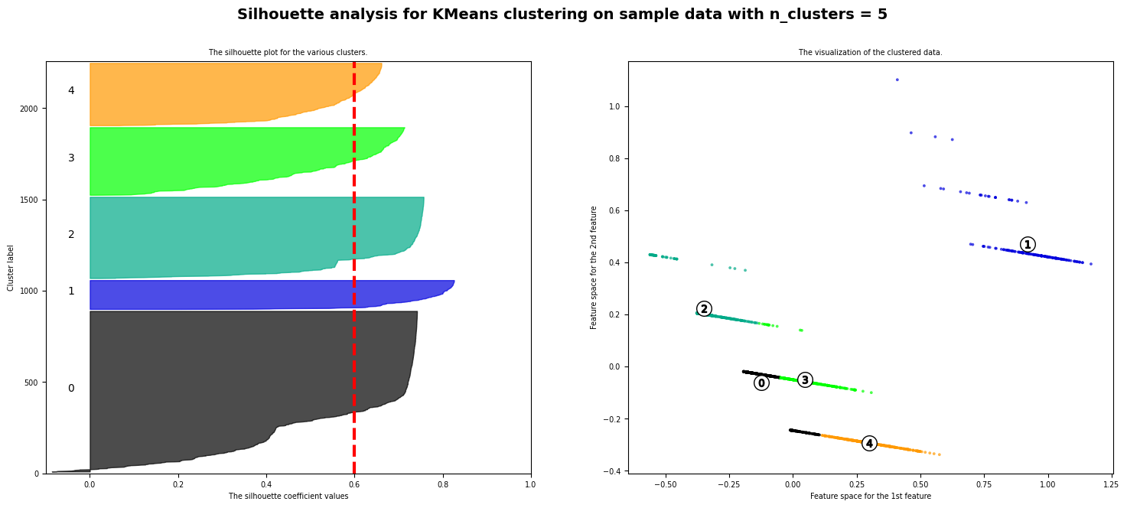
Silhouette Score
Please check this Jupyter Notebook file here for more details

Slide 24
Cluster Interpretation
Cluster 0: Moderate Spenders with Children & Low CR
Total_Spend: Average spending is moderate (mean: ~173,084)
CR: Low conversion rate (mean: 0.0136),
Children: Most have children (mean: ~0.84),
Income: Moderate income level (mean: ~36.5 million).
Cluster 1: High Spenders with Low Children Count & High CR
Total_Spend: Very high spending (mean: ~1.6 million)
CR: High conversion rate (mean: 0.245)
Children: Few have children (mean: 0.19)
Income: Highest income among clusters (mean: ~82.2 million).
Cluster 2: Low to Moderate Spenders with Many Children & Low CR
Total_Spend: Low to moderate spending (mean: ~205,451)
CR: Low conversion rate (mean: 0.0145)
Children: High number of children (mean: 2.1)
Income: Slightly higher income than Cluster 0 (mean: ~43.5 million).
Cluster 3: High Spenders with Children and Low CR
Total_Spend: High spending (mean: ~1.03 million)
CR: Low conversion rate (mean: 0.0145)
Children: Most have one child (mean: 1.04)
Income: Relatively high income (mean: ~64.7 million)
Cluster 4: High Spenders without Children and Moderate CR
Total_Spend: High spending (mean: ~1.3 million)
CR: Moderate conversion rate (mean: 0.0946)
Children: No children (mean: 0.0)
Income: High income (mean: ~72.1 million).
Please check this Jupyter Notebook file here for more details

Slide 25
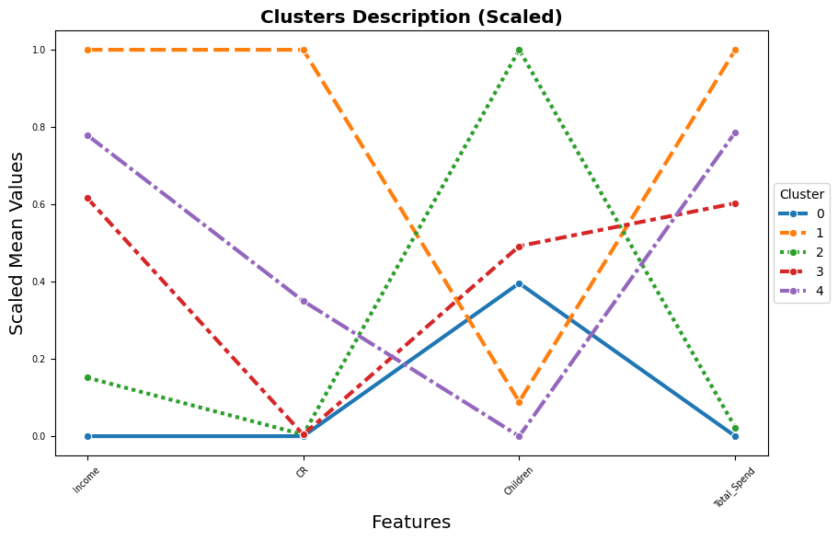
Cluster Interpretation
Please check this Jupyter Notebook file here for more details

Slide 26
Business Recommendation
Cluster 1 (Main Focus)
high-value and high-conversion group, and it’s worth investing in premium marketing strategies tailored to their preferences.
Clusters 0 and 2
have low conversion rates and moderate to low spending, likely because of family responsibilities. Consider family-oriented campaigns or promotions.
Clusters 3 and 4
high spenders but differ in family status. Personalized marketing emphasizing convenience or exclusivity could be effective.
Please check this Jupyter Notebook file here for more details

Slide 27
Thank You

